Slide 1
Fuzzy Logic and Fuzzy State Machines
Module CE1184a/k
AI for Games
Dave King

Slide 2
Overview
Introduction
The concept of ‘fuzziness’
Fuzzy sets
Set operations
Fuzzy reasoning
Developing a fuzzy system
Combinatorial Explosion
Fuzzy State Machines
Type-2 Fuzzy Logic
Summary
References

Slide 3
Introduction - 1
“It (fuzzy logic) can add depth and unpredictability to your game AI…” Jeff Orkin [1]
Fuzzy = smooth, more ‘humanlike’ transitions [2]
Fuzzy rules equivalent to rules-of-thumb we use and make it easier to come up with better rules [3]
“Fuzziness is used as a concept (in game AI), but fuzzy logic is simplified to crisp levels for efficiency” [4]

Slide 4
Introduction - 2
After this lecture you should be able to:
  Discuss the differences between crisp and fuzzy propositions
  Illustrate, using examples, how a fuzzy inference system works
  Describe the underlying concepts of fuzzy inference systems
  Explain possible applications of fuzzy logic in games AI design

Slide 5
The concept of ‘fuzziness’ - 1
Natural language contains uncertainties and ambiguities
We say things like:
  ‘quite tall’
  ‘very tall’
  ‘middle aged’
  ‘quite compact’
  ‘relatively few’ etc.
Ambiguities resolved by individual knowledge and understanding of the topic

Slide 6
The concept of ‘fuzziness’ - 2
Natural language is consistent with the way we respond to our environment
E.g. ‘a comfortable temperature’ will cover a wide range of temperatures dependent on the individual
Or a group of formula one drivers might have a different interpretation of ‘fast’ than the average motorist

Slide 7
The concept of ‘fuzziness’ - 3
Fuzzy systems originated because the real, analogue world has no absolutes
There is a gradual transition from one state or condition to another
On the other hand computers can only deal with crisp data
  Everything is either ‘1’ or ‘0’, TRUE or FALSE, ‘on’ or ‘off’

Slide 8
The concept of ‘fuzziness’ - 4
Example – seasons of the year (using ‘crisp’ data)
1
Spring
Summer
Autumn
Winter
Degree of membership
0
March
June
September
December
March
Crisp sets for seasons of the year

Slide 9
The concept of ‘fuzziness’ - 5
Seasons of the year – fuzzy version
1
Spring
Summer
Autumn
Winter
Degree of membership
0
March
June
September
December
March
Fuzzy sets for seasons of the year

Slide 10
The concept of ‘fuzziness’ - 6
Fuzzy sets reflect the real world and our ways of describing it
  E.g. ‘It may be Winter, but I feel a hint of Spring in the air’
A fuzzy proposition contains words such as ‘tall’, ‘average’ or ‘short’
These words define the respective fuzzy sets TALL, AVERAGE and SHORT

Slide 11
The concept of ‘fuzziness’ - 7
Fuzzy logic developed from the ideas of Lotfi Zadeh in the mid 60s
Key paper ‘Fuzzy sets’ published in Information and Control in 1965
Zadeh described the mathematical background for fuzzy sets and their inter-relationships
Leading to many applications such as:
  Engine management, Anti-lock breaks
  Transmission control, Blast furnace control
  Image/pattern recognition, Planning and scheduling
  Air conditioning, Washing machines, Video cameras, etc.

Slide 12
The concept of ‘fuzziness’ - 8
List is not comprehensive
Illustrates scope for fuzzy systems in control and operation of engineering systems
Advantages of using fuzzy systems
  Their operation reflects way a human operator would control the system
  Alleviates need for detailed mathematical model of system

Slide 13
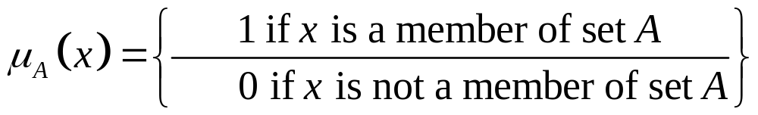
Fuzzy sets - 1
A crisp membership set is defined by a characteristic function such that
  It has the value ‘1’ if the object is a member of the set
  It has the value ‘0’ if the object is not a member of the set
  (1)

Slide 14
Fuzzy sets - 2
In a fuzzy set the characteristic function is replaced by the membership function
  It can have any value between ‘0’ (no membership) and ‘1’ (full membership)
  The actual value of the membership function is the grade or level of membership

Slide 15
Fuzzy sets - 3
Example – consider concepts of ‘short’, ‘average height’ and ‘tall’
Group of people ranging from 1m (~5ft 3in) to 2m (~6ft 7in)
Using crisp sets we might define
  Everyone less than 1.62 m (~ 5ft 4 in) as ‘short’
  Everyone between 1.62 m and 1.78 m (~ 5ft 10 in ) as ‘average height’
  Everyone taller than 1.78 m as ‘tall’

Slide 16
Fuzzy sets - 4
1
short
These definitions are shown graphically
0
1
1.5
2
height
1
average height
0
1
1.5
2
height
1
tall
0
1
1.5
2
height
Crisp sets for peoples’ height

Slide 17
Fuzzy sets - 5
If a fuzzy representation is used then short, average height and tall individuals will blend in with each other
There is significant overlap between the individual membership functions

Slide 18
Fuzzy sets - 6
1
short
Thus someone 1.8m (~ 5ft 11in) would have values
  0.5 for set ‘average height’
  0.4 for set ‘tall’
0
1
1.5
2
height
1
average height
0.5
0
1
1.5
2
height
1
tall
0.4
0
1
1.5
2
height
Fuzzy sets for peoples’ height

Slide 19
Fuzzy sets - 7
The domain of a fuzzy set is the universe of values making up the set
In this case the fuzzy set for ‘middle age’ has a domain bounded by 35 years and 60 years
1
Membership function μ[x]
Middle age
0
30 35 40 45 50 55 60 65
Age (years)
Fuzzy set for MIDDLE AGED

Slide 20
Fuzzy sets - 8
System space often contains a number of overlapping fuzzy sets
The range of temperatures from 40⁰C to 400⁰C is the universe of discourse of the system
Cold
Cool
Correct
Warm
Hot
1
Membership function μ[x]
0
40
100
200
300
400
Temperature (⁰C)
Universe of discourse for TEMPERATURE

Slide 21
Fuzzy sets - 9
Representation of fuzzy sets
  Typical shapes are shown below:
Ascending S-Curve
Descending S-Curve
Linear
Piecewise Linear
Gaussian or Bell Curve
Triangular
Offset Triangular
Truncated
Trapezoidal
Fuzzy set shapes

Slide 22
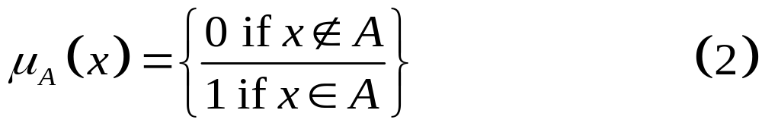
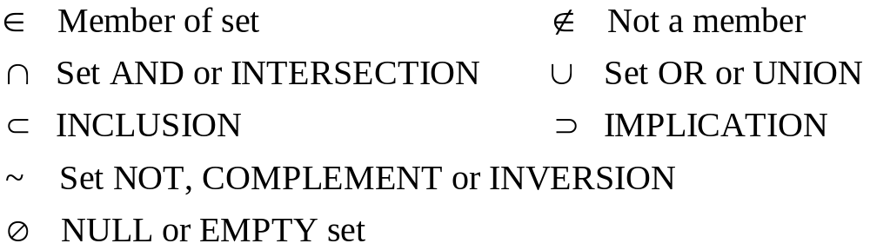
Set operations - 1
For a crisp set the Boolean relationship of equation (1) can be written as:
The logical operators ∈ and ∉ are defined in the following table

Slide 23
Set operations - 2
For crisp sets there is no ambiguity about membership
Basic set operations (right) result in new crisp sets
X
X
~A
B
A
A
A ⊂ B
Inclusion of set A within set B
~A
Set A & Compliment ~A
X
X
A
B
A B
A ∩ B
Intersection of sets A & B
A ∪ B
Union if sets A & B
Crisp set operations

Slide 24
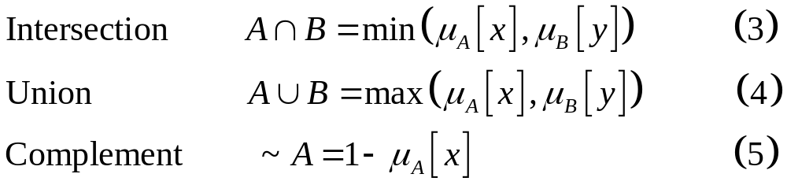
Set operations - 3
In fuzzy sets the same operations of intersection, union and compliment exist
However, they are interpreted differently to crisp sets

Slide 25
Fuzzy reasoning - 1
Fuzzy reasoning or fuzzy inference forms the basis of fuzzy expert systems
Similar to conventional expert systems
  Structured around a knowledge base
  Around a set of fuzzy rules
  Similar ‘IF…THEN…’ structure
  But rules contain fuzzy propositions

Slide 26
Fuzzy reasoning - 2
Size of the rule base is a particular concern with complex systems
Break down rule base into series of related modules
Each of which will be a more manageable size
Using this modular approach it is possible to restrict number of rules while retaining overall performance

Slide 27
Developing a fuzzy system - 1
Define Problem in Terms of Fuzzy Statements
Choose Suitable Membership Functions
Decide on a Defuzzification Method
Tip Example - Fuzzy Rules
  Rule 1: IF ‘service is poor’ OR ‘food is bad’ THEN ‘tip is low’
  Rule 2: IF ‘service is good’ THEN ‘tip is average’
  Rule 3: IF ‘service is excellent’ OR ‘food is delicious’ THEN ‘tip is generous’
Create Membership Functions

Slide 28
Developing a fuzzy system - 2
Poor
Good
Excellent
Bad
Good
Delicious
1
1
0
0
0
Service
10
0
Food
10
Low
Average
Generous
1
Membership functions for tip example
0
0
Tip
30

Slide 29
Developing a fuzzy system - 3
Rule 1
Rule 2
Rule 3
0
10
0
10
Fuzzy Inference System (FIS) for tip example
0
30
Service = 2.5/10
Food = 7.5/10
Tip = 17%

Slide 30
Developing a fuzzy system - 4
Defuzzification
  Converts fuzzy outputs to crisp values
  Three most commonly used methods are:
    Mean of maxima
    Centre of maximums
    Centre of gravity (or centroid)
  Mean of maxima
    The limits of the fuzzy output which are at the maximum value are identified
    The mean value of these limits becomes the crisp output

Slide 31
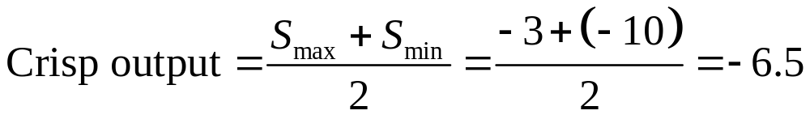
Developing a fuzzy system - 4
1
1
-2
-10
-3
-10
11.33
-3
0.5
0.5
0.33
-20
-14
-10
0
10
14
-20
-10
0
10
Output
Output
Original fuzzy output
-6.5
Mean of maxima
Fuzzy output produced by active rules
Defuzzification using mean of maxima method

Slide 32
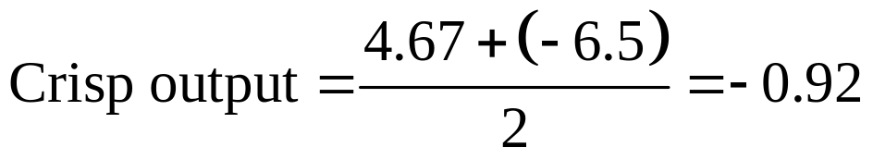
Developing a fuzzy system - 5
Centre of maximums
  Used when the fuzzy output has a number of levels
  Highest and next highest plateau are identified
  Crisp output is the midpoint between the centres of the two plateau
1
-2
-10
-3
0.5
11.33
0.33
-20
-14
-10
0
10
14
Output
-6.5
4.67
-0.92
Centre of maximums
Defuzzification using centre of maximums method

Slide 33
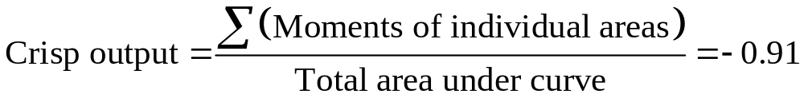
Developing a fuzzy system - 6
Centre of gravity
  First moment of area is used to find the centroid of the fuzzy output
  This point gives the crisp output
1
-2
-10
-3
0.5
11.33
0.33
-20
-14
-10
0
10
14
Output
-0.91
Centre of gravity
Defuzzification using centre of gravity method

Slide 34
Combinatorial Explosion - 1
Number of Variables | No of mf’s Per Variable | Number of Rules
2 | 5 | 5² = 25
3 | 5 | 5³ = 125
4 | 5 | 5⁴ = 625
5 | 5 | 5⁵ = 3 125
6 | 5 | 5⁶ = 15 625
7 | 5 | 5⁷ = 78 125
8 | 5 | 5⁸ = 390 625
9 | 5 | 5⁹ = 1 953 125
10 | 5 | 5¹⁰ = 9 765 625

Slide 35
Combinatorial Explosion - 2
We can cut down rules by avoiding unwanted states
Alternatively the ‘Combs Method’ reduces problem from exponential to linear expansion [5]
Each input membership function relates to a single output membership function
A good, simple, games related example of the ‘Combs Method’ is given by Michael Zarozinski of Loader Than A Bomb! software [6]

Slide 36
Fuzzy State Machines
Extension to standard finite-state machine
Instead of processing crisp symbols both inputs and outputs are fuzzy values
Advantage of smooth control and reasoning with degrees of truth which often proves more humanlike [2]
Internally each state can be defined as a fuzzy variable too
This can lead to problem of combinatorial explosion

Slide 37
Type-2 Fuzzy Logic - 1
Second level of fuzziness is introduced [7]
Width and position of the individual mfs defined in a fuzzy manner
  Rule 1. IF ‘x is a’ THEN ‘Width is Narrow’
  Rule 2. IF ‘x is b’ THEN ‘Width is Medium’
  Rule 3. IF ‘x is c’ THEN ‘Width is Wide’
Footprint of uncertainty

Slide 38
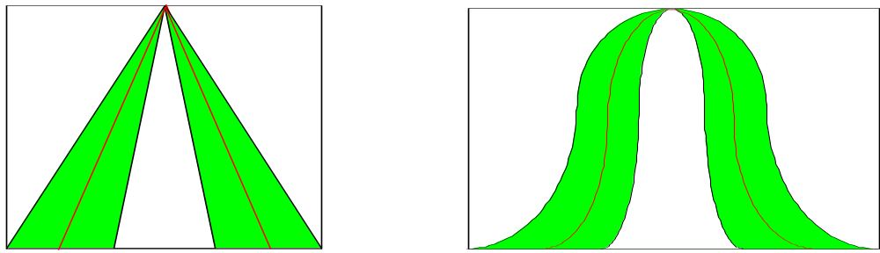
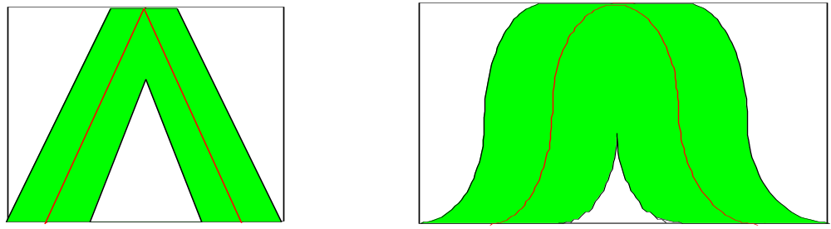
Type-2 Fuzzy Logic - 2
Width varied dynamically
Or position
Or both
Footprint of uncertainty – varying width
Footprint of uncertainty – varying position

Slide 39
Summary - 1
Natural language
  Fuzzy v Crisp representation
Fuzzy logic
  Applications
  Fuzzy sets
    Domain
    Universe of discourse
    Shapes
  Set operations
    Fuzzy AND & OR

Slide 40
Summary - 2
Developing a fuzzy system
  Similar to an expert system
  Tip example
  Defuzzification
Combinatorial Explosion
Fuzzy State Machines
Type-2 Fuzzy Logic

Slide 41
References - 1
Jeff Orkin, AI Game Programming Wisdom – Vol.2, Charles River Media, USA, 2003, p101.
Alex Champandard, AI Game Development – Synthetic Creatures with Learning and Reactive Behaviours, New Riders Publishing, USA, 2004, p541.
William van der Sterren, AI Game Programming Wisdom – Vol.2, Charles River Media, USA, 2003, pp251-252.

Slide 42
References - 2
Alex Champandard, AI Game Development – Synthetic Creatures with Learning and Reactive Behaviours, New Riders Publishing, USA, 2004, p401.
William E Combs, The Fuzzy Systems Handbook 2nd. Ed., Academic Press, 1999.
Michael Zarozinski, Game Programming Gems 2, Charles River Media, USA, pp342-350.
type2fuzzylogic.org

Slide 43
References - 3
Bradley et al, Mechatronics and the design of intelligent machines and systems –– Ch.6.10-6.14
J.M. Mendel, Uncertain Rule-Based Fuzzy Logic: Introduction and New Directions, Prentice-Hall, 2000. (For information on type-2 fuzzy logic)
Matlab Fuzzy Logic Toolbox manual

